Slide 1
Stuff for Econ 425 Project, FNN

Slide 2
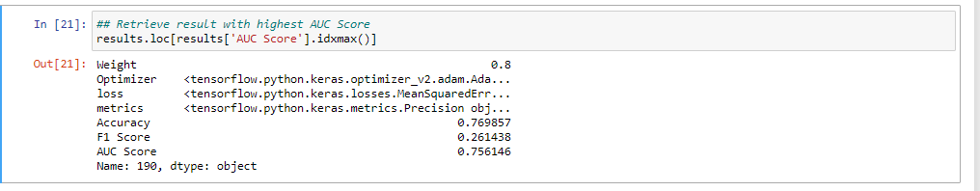
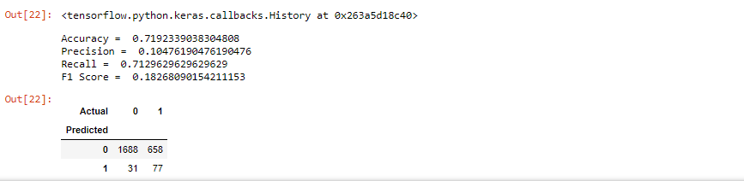
OverSampling, scaled data, best model based on highest AUC Score

Slide 3
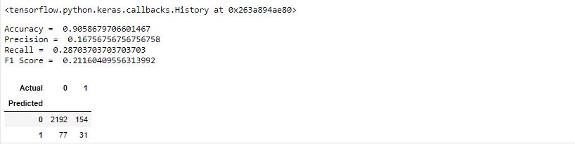
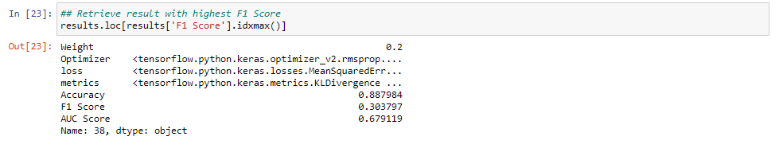
OverSampling, Scaled Data, Best model based on F1 Score

Slide 4
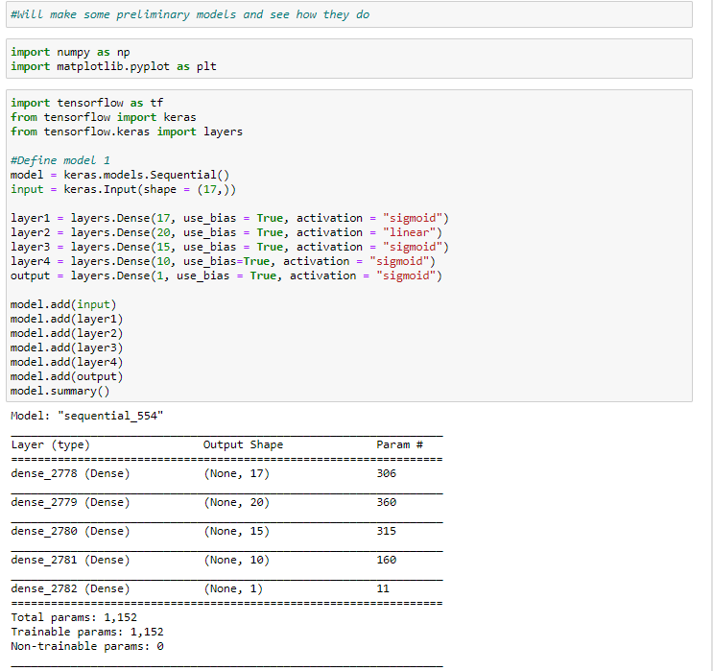
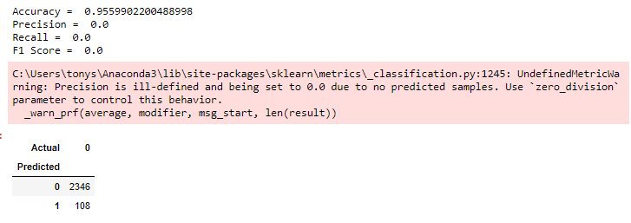
Scaled Data, Baseline FNN

Slide 5
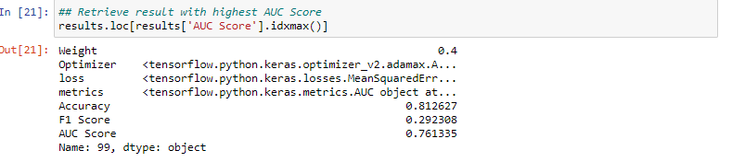
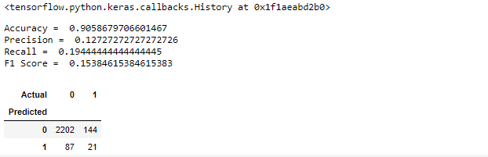
Oversampling, Unscaled Data, Best Model based on AUC Score

Slide 6
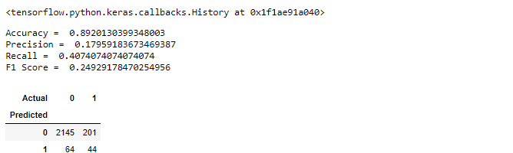
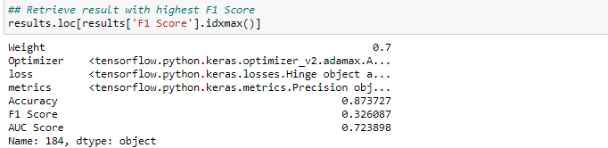
Oversampling, Unscaled Data, Best model based on F1 Score

Slide 7
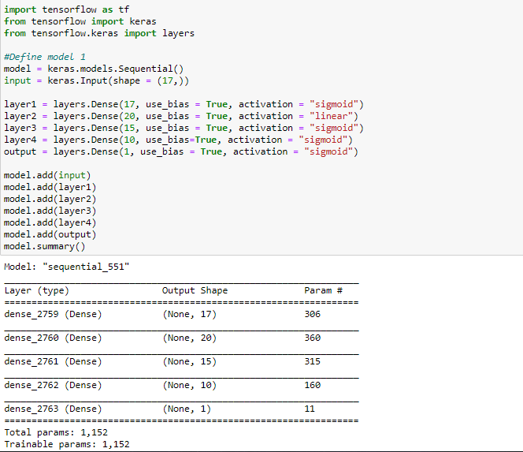
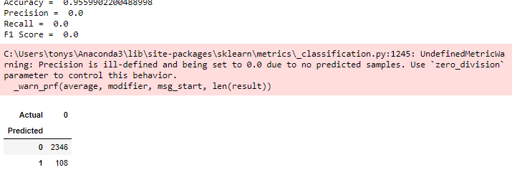
Unscaled, Baseline FNN model

Slide 8
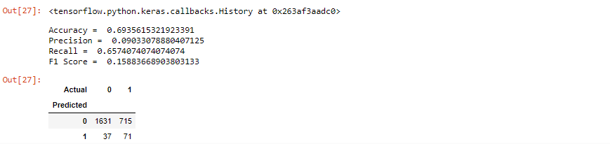
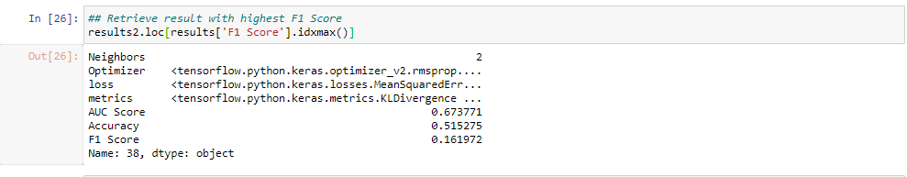
UnderSampling,Scaled Data,Best Model based on F1 Score

Slide 9
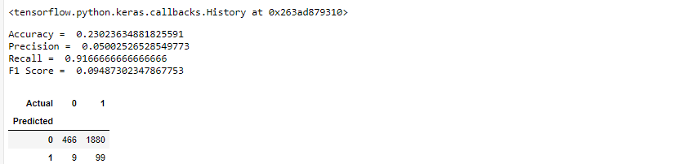
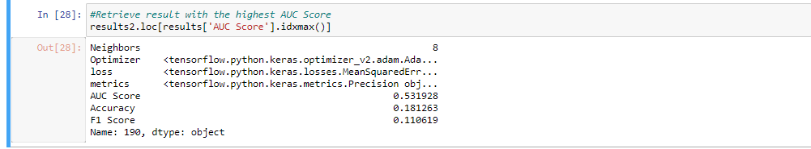
UnderSampling, Scaled Data, Best Model based on AUC Score

Slide 10
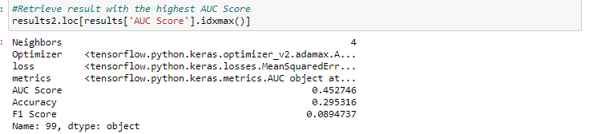
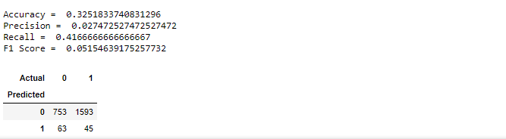
Under Sampling, Unscaled, Best Model based on AUC Score

Slide 11
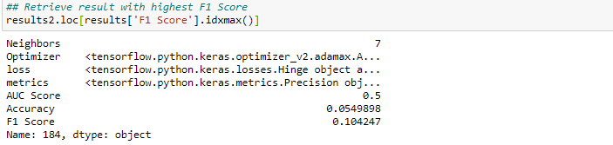
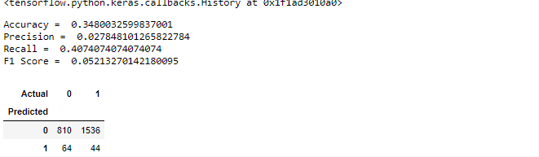
UnderSampling, Unscaled, Best model based on F1 Score

Slide 12
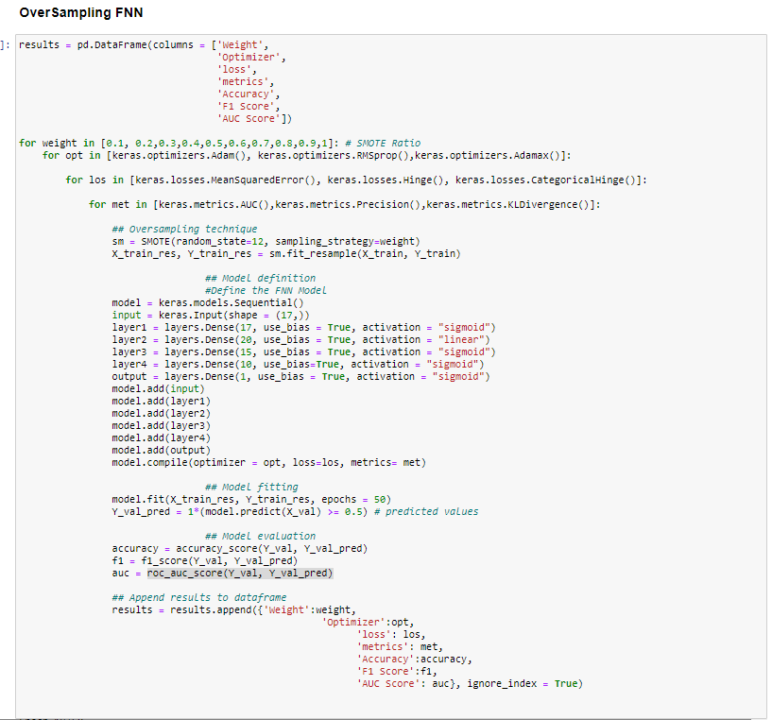
Code for OverSampling

Slide 13
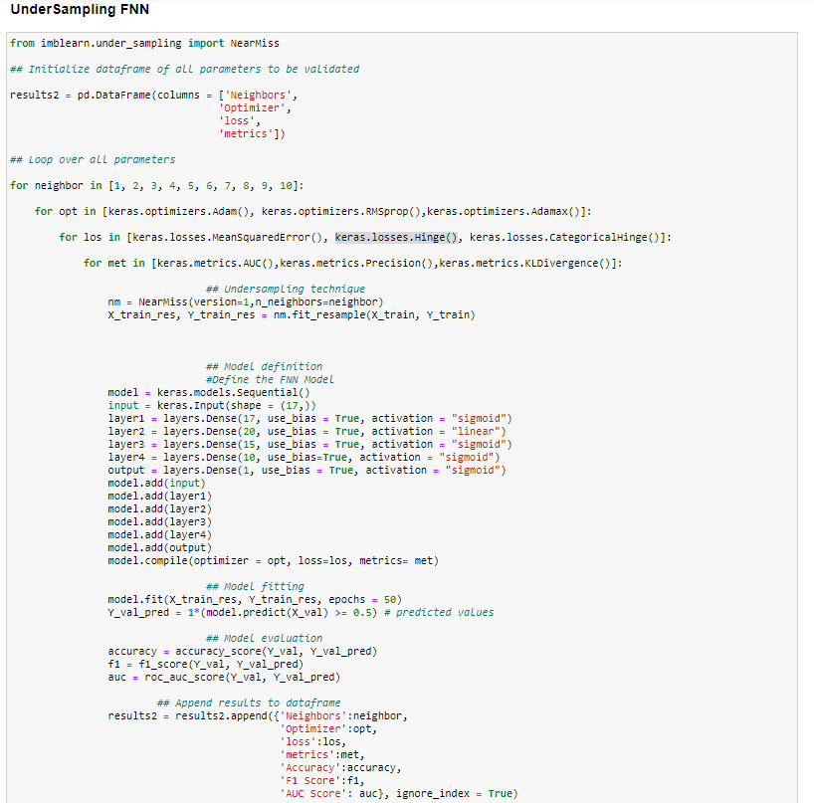
Code for UnderSampling

Slide 14
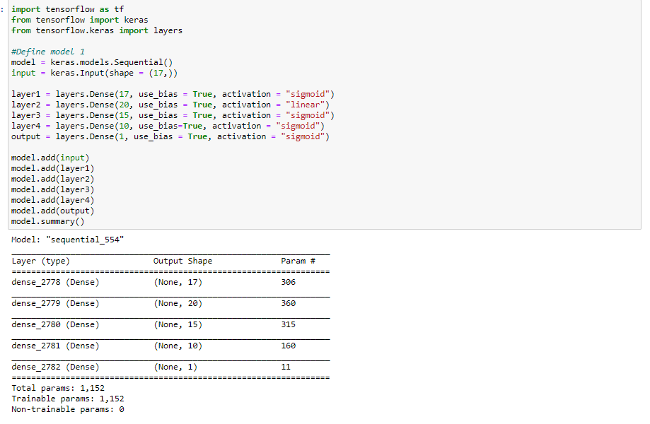
FNN Model, used in the for loop

